Slide 1


1 Capstone Project Phase
GiveUs-
an application for linking and coordinating donations
Zohar Barel
David Blanka

Slide 2


Contents
Introduction
Solution
product
Verification
Challenges

Slide 3
Introduction- Background
❗ Today 21% of the population in Israel lives below the poverty line.
❗During the year 2021, 1600 tons(out of 2.6 million tons), with a value of 16 million NIS, were saved as part of the food rescue project of the organization "Latet"
❗But... how much food is not collected? How much food is thrown away due to lack of coordination, lack of knowledge or lack of accessibility?

Slide 4
NO MORE!!!
❗40% of the food in Israel is thrown away when more than half of it is edible!!!
coffee shop, dining rooms, event halls, supermarkets... everyone tries to contribute but it's not enough...

Slide 5

Solution
give-us is a system that connects donors and those in need.
This is the best way to connect large organizations with non-profit organizations and between small organizations and private individuals in need.
The system simplifies the whole donation issue, streamlines the process, saves valuable time.
The system can prevent edible food from being thrown away and donate it to non-profit organizations and also allow private individuals to collect surplus food from businesses in their area of residence.
Donating food has never been easier!

Slide 6
Solution- outline
Posting small donations
Link between large organizations and non-profit organizations
Accessibility to donors and those in need
Keeping the information about the donations

Slide 7
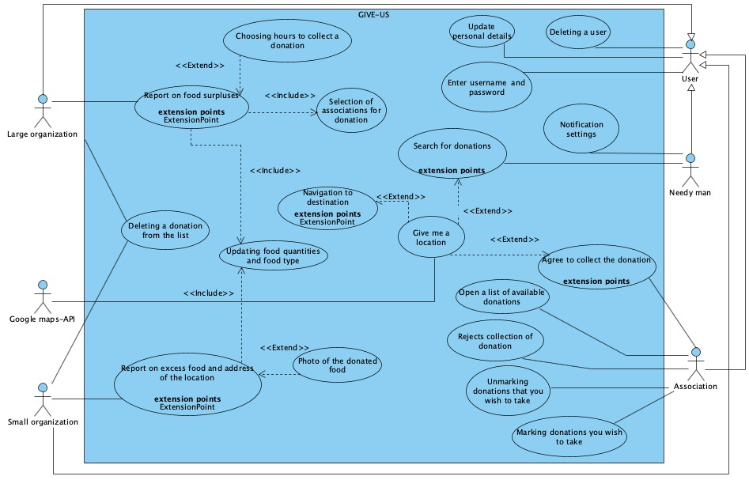
Product - Use Case diagram

Slide 8
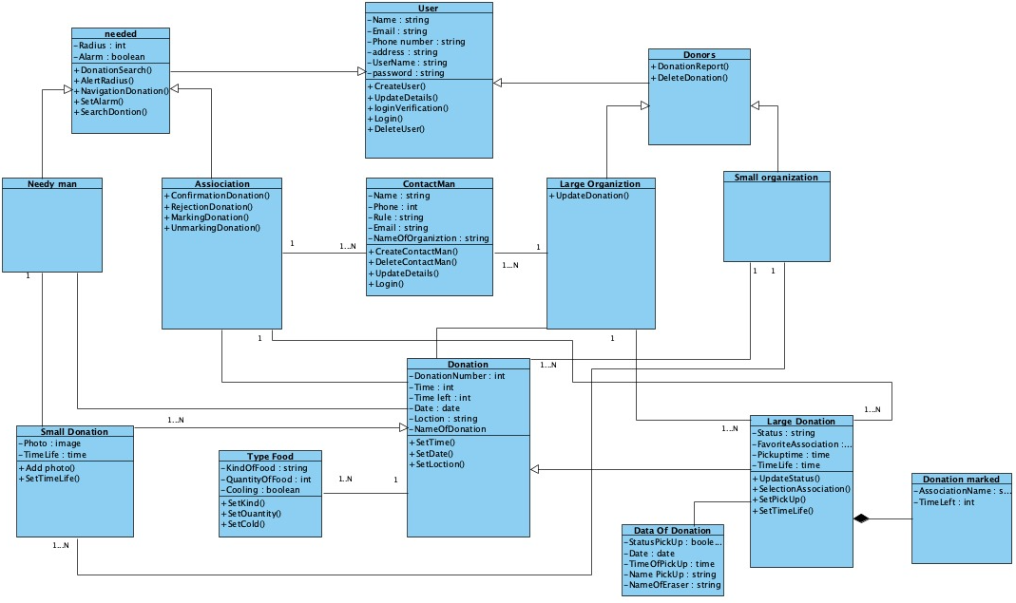
Class diagram

Slide 9
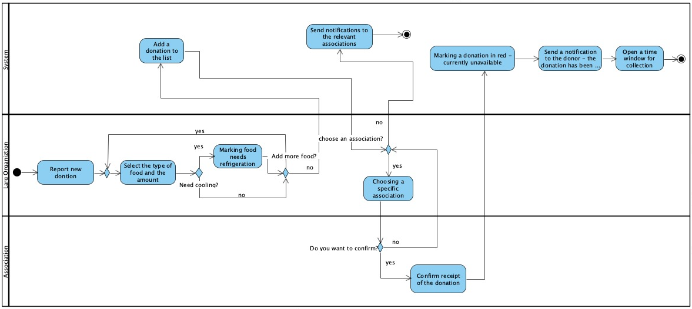
large donation of a large organization Activity Diagram

Slide 10
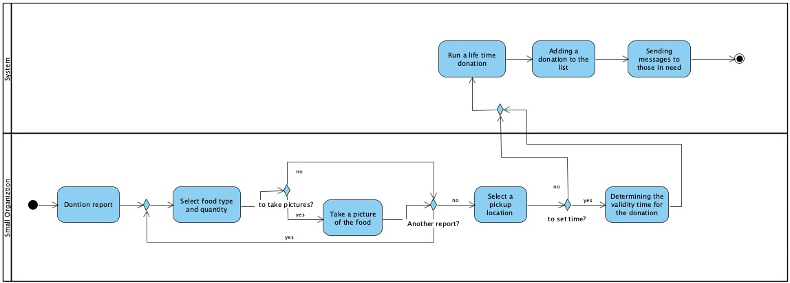
small donation of a small organization Activity Diagram

Slide 11
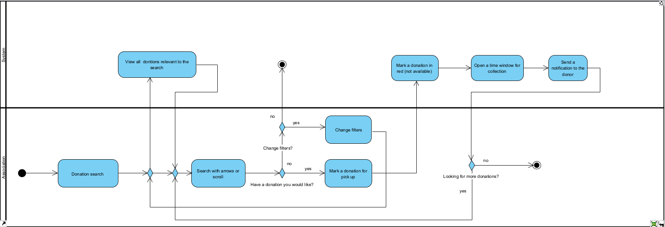
Search donation Activity Diagram

Slide 12
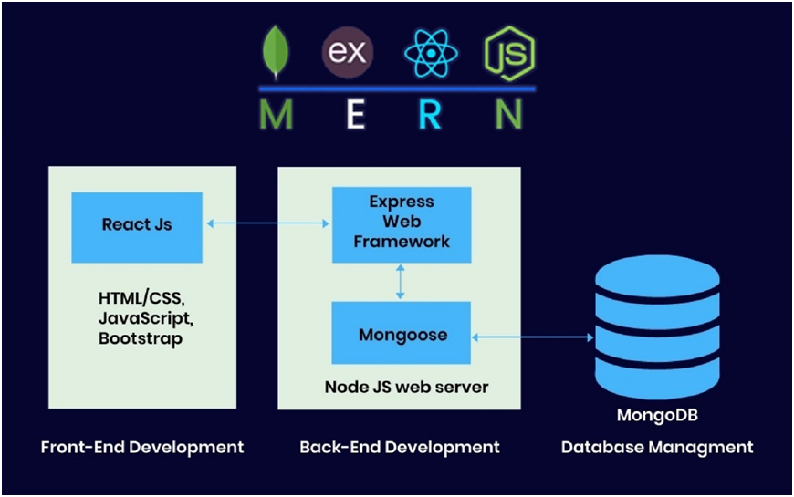

Slide 13
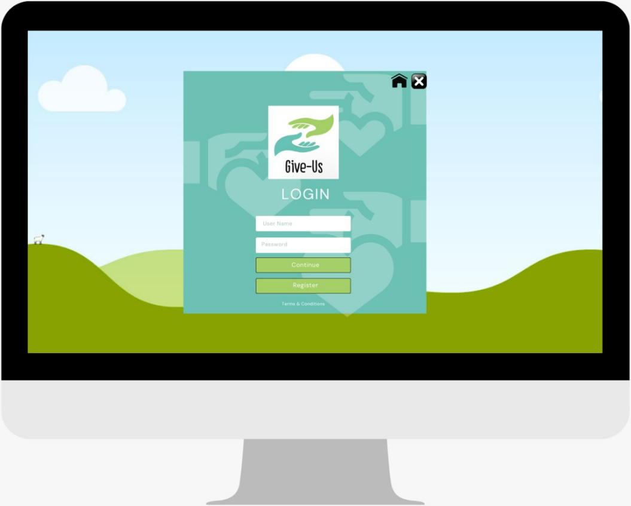
GUI -Login page

Slide 14
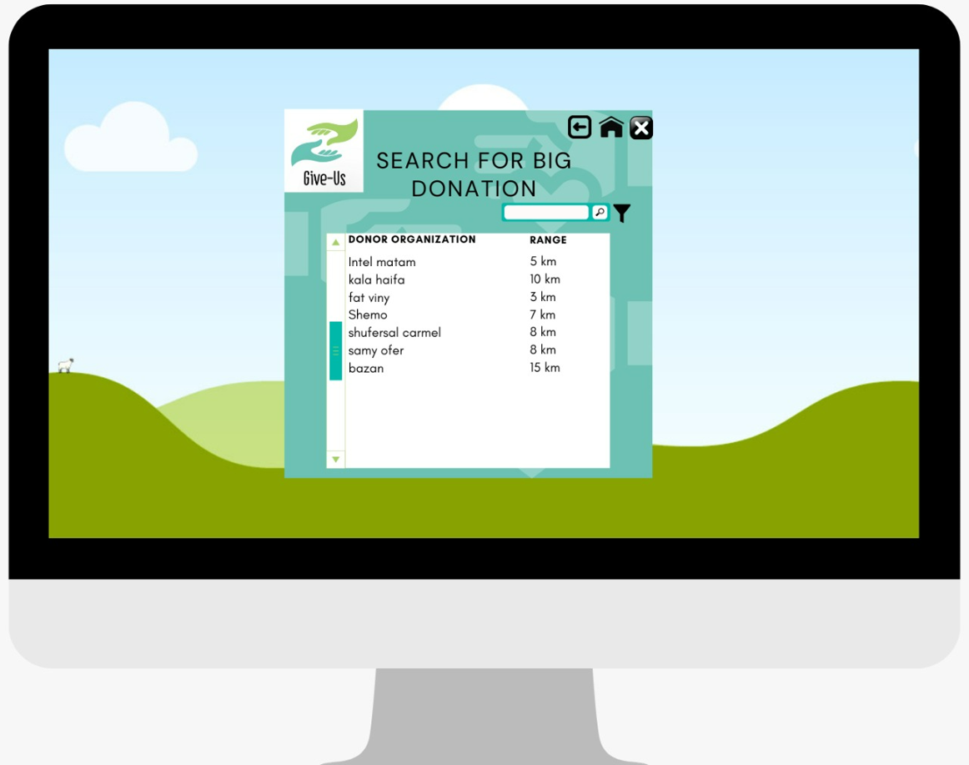
Searching page

Slide 15
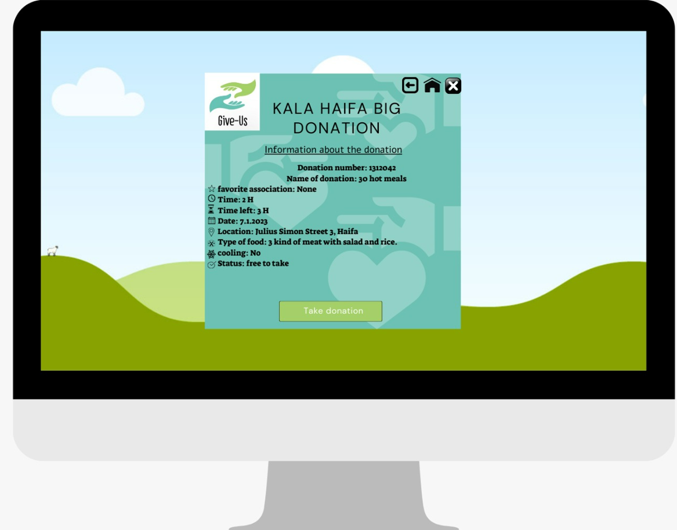
Information on donation page

Slide 16
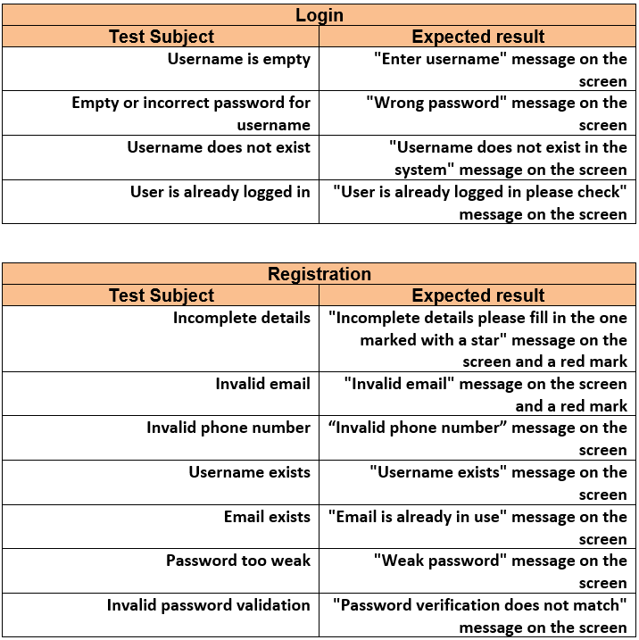
Verification- Testing

Slide 17
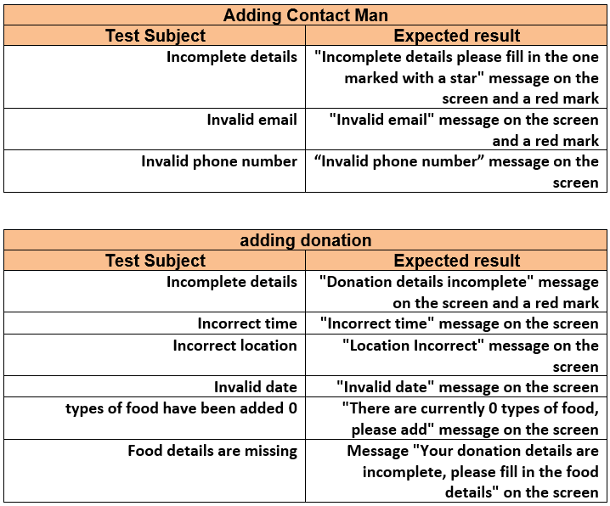

Slide 18
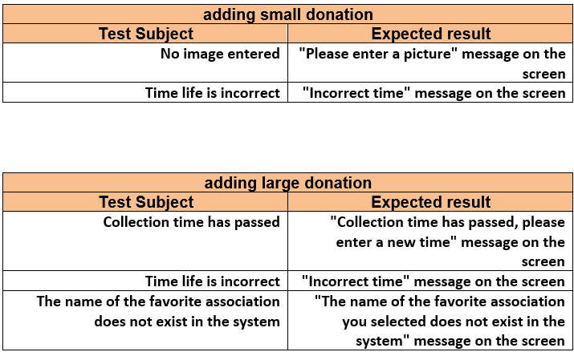

Slide 19
Challenges

Slide 20
Thank you for listening 🙌🏽
Go and donate!

